Slide 1
Understanding Today’s Workforce in a Digital Age
NBCDA/ November 2018 conference

Slide 2
Understanding generational divides in today’s job market
Identifying talent acquisition barriers between Gens Y & Z and potential employers
Simple strategies that work for both youth and employers

Slide 3
Who are they?
Getting to know - generations X e& Z?
Strengths, challenges and what drives them
How to better prepare this generation for today’s job market?

Slide 4
5 GENERATIONS – 1 JOB MARKET
Maturists pre - 1945
Baby Boomers - 1945-1962
Baby Busters – 1963-1980
Gen X (Millennials) 1975-1984
Gen Y(Millennials) 1984-1994
Gen Z or IGen 1995-2013
Gen Alpha 2014-

Slide 5
UNDERSTANDING GENERATIONAL DIVIDES

Slide 6
GENERATIONS Y & Z HOW THEY COMMUNICATE
Generation Y
2 screens
Keep in touch through texting & messaging apps
Share and adjust information
Their focus is on the very short term – the now
Optimists
Wish to be discovered
Generation Z
5 screens – all mobile
Communicate with photos and video
Create their own content
Their focus is on their future
Realists
Prepared to work for their comfort and success

Slide 7
GENERATIONS Y & Z and their relationships
Generation Y
Friends are family
Share and seek out their friends opinions before making major decisions
Prefer designer brands
Are looking for new experiences
Generation Z
Both parents and friends are important to them
Research anything before making a decision
Prefer products and services that are local, environmentally friendly
Are concerned about climate change and our planet’s future

Slide 8
Challenges of Gens Y & Z
Missing soft skills:
Answering a phone & taking a message
How to participate in a meeting
How to write a clear and concise email
Understanding their place within a hierarchy
Communicating clearly without images
How to get to know and work with other generations besides their own

Slide 9
GEN Z’s at work
Quicker to pick up on missing soft skills
Will change careers several times
Are not overly concerned about loosing their job
Want jobs that are mobile
Seeking good working conditions
Don’t function well within a traditional corporate hierarchy
Prefer to work on projects and not profit margins
Always looking to acquire new knowledge

Slide 10
TOOLS FOR GENS
Y & Z

Slide 11
Voice mails, phones and emails
Many potential candidates don’t have voicemail, or phone function on their Smartphones and never check email
Very few NB employers are willing to text potential candidates – but this is changing
Let your clients know that these components should be in place and checked regularly when starting a job search!

Slide 12
Google yourself
Google search your name
Note the top 5 that appear – do you want an employer to see that?
Do a Google image search as well. (tagged photos show up here)
Google yourself after 11pm – the outcomes may change

Slide 13
‘’Clear or hide ‘iffy’ content
Photos
Vidéos
Blog post
Comments from friends and family
Party, sex or drug content
Pages you like that you don’t want to share with your mom or grandma

Slide 14
Review your social media accounts
Add a few updates that can impress an employer
Make sure your security settings are working for you
Hide or file photos and videos that are iffy
Google yourself
As a college or university grad you should have a LinkedIn account
Never use a logo or avatar as your photo on LinkedIn.

Slide 15
GEN X et Z resume tools

Slide 16
Prepare for the interview
Make sure LinkedIn is up to date
Research a potential employer (even if its Tim Horton’s)
Check your spelling and grammar
Reread the job post and make sure you are qualified
Include a short intro letter or email
Make sure to have 1 or 2 questions for the interviewer (not about money)
Have references ready!

Slide 17
Say hello to potential employers

Slide 18
Follow employers on line
You can check them on LinkedIn, Facebook, Twitter, Medium, Tumblr et Instagram and follow them

Slide 19
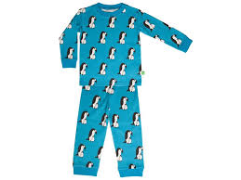
Avoid these mistakes!

Slide 20
FIRST IMPRESSIONS
Arrive at interview 15 minutes ahead of time
Make sure you are dressed to impress. Avoid jeans if possible
Look at the interview while answering questions
Practice your hand share make sure its firm but not too stong. Make sure your palms are dry
Avoid perfumes of any kind (Axe, Gain, ect)
Make sure you know what’s on your resume.

Slide 21
WHY LINKEDIN MATTERS

Slide 22
Employers love Linkedin because it offers a great resume with more details
Timelines and previous experience is easier to check
Candidates can include photos, videos, volunteer experience and travel
Descriptions should be clear and concise
LinkedIn offers a professional looking resume that is easy to update.
A LinkedIn account shows you are serious about your job search.

Slide 23
Generation Alpha / 2014 to ?
WHAT TO EXPECT OF THE PRESENT DAY THREE YEAR OLDS?

Slide 24
STRATEGIES & TOOLS FOR EMPLOYERS

Slide 25
Talent Acquisition Strategy
GOAL: Attract Best Talent in a cost and time effective way
Design sharp job ad
Post ad on Indeed.ca Jobs.ca Eluta.ca
Place job ad on website, FB page, Twitter & Instagram
Manage job ad posts with Quimble, Hootsuite, email...
Post on LinkedIn (CareerBeacon much less popular)
Prepare online survey as screening tool
Interview questions, hiring grid & reference check forms
Social Media strategy: blog posts, retweets FB ads, email to networks

Slide 26
Talent Acquisition Strategy ( simplified for smaller companies)
maximize time and money
Post simple job ad
Use free job sites
Indeed.ca Jobs.ca Kijiji.ca
Get through process as quickly as possible
Quick interview
Reference check (not always consistent)
Some social media

Slide 27
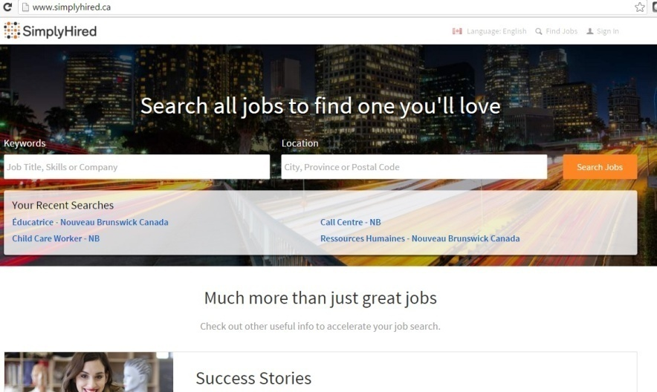
TRUSTED PAID JOB POSTING SITES

Slide 28
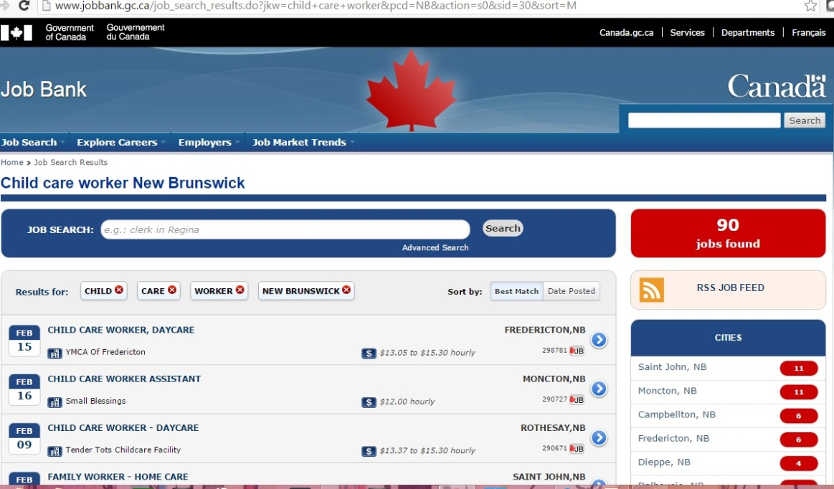
TRUSTED FREE JOB POSTING SITES

Slide 29
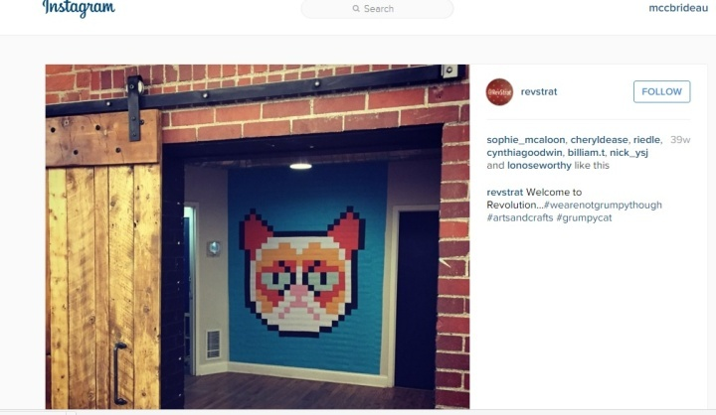
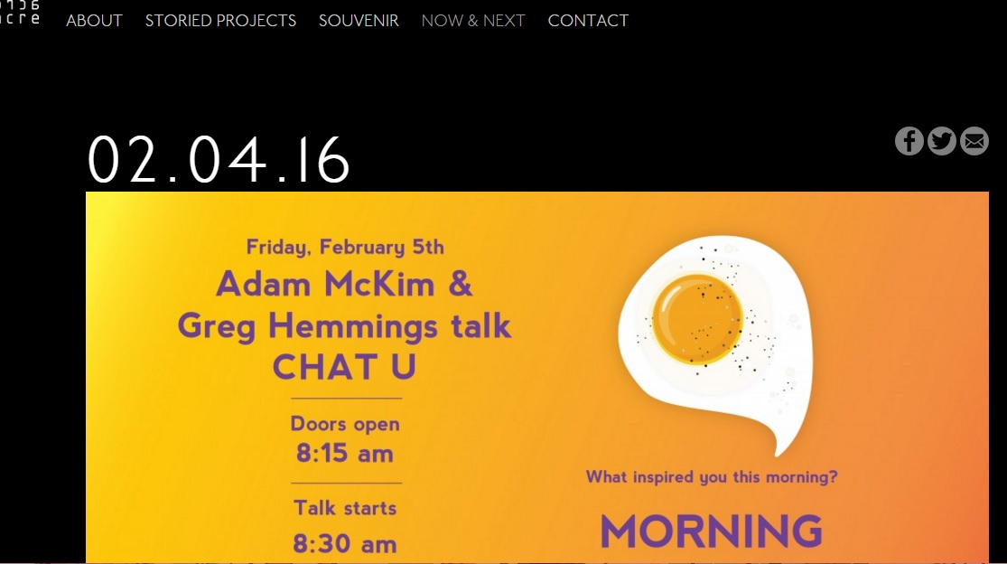
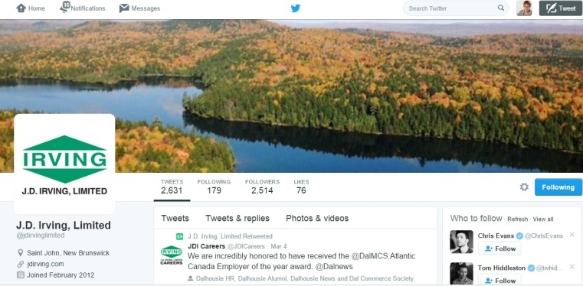
INTERACTING WITH POTENTIAL CANDIDATES ON SOCIAL MEDIA

Slide 30
NEW SCREENING METHODS

Slide 31
Tips and tools
Send potential candidates sample interview questions to maximize your interview time and allow them to relax and share more pertinent info.
Offer them a tour of their potential work area if the interview went well.
If more than one interviewer make sure to introduce everyone as well as their title. Avoid a 3 to 1 or higher ratio – advise candidate if this will be a panel interview
Choose a room with natural sunlight and plenty of room for everyone – you will get better answers to your questions.

Slide 32
Tips and tools
Make sure your questions are not yes and no answers.
If a candidate is shy or visibly nervous offer them some water and a chance to collect their thoughts
Use a hiring grid
If candidate is not a good fit consider ending the interview after 15 to 20 minutes
Ask candidate questions about your company
Use the talent acquisition graph as a guide and action plan for recruiting

Slide 34
Sample hiring grid

Slide 35
JOB ADS
Have gotten more creative
Competition for new talent can be fierce
A chance to get your company noticed
Must be clear and concise
Must appear on several sites
Must be shared on social media too!

Slide 36
Interview questions & hiring grid
Use smart questions
Use the same questions for all candidates
Take notes
It helps to be two people in the interview

Slide 37
ALWAYS DO 2-3 REFERENCE CHECKS !!!

Slide 38
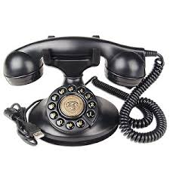
THE INTERGENERATIONAL JOB MARKET p.23
From newspaper job ads, job boards and getting a job where your dad works to global job markets, LinkedIn, Skype interviews and collaborating with peers from all over the world.

Slide 39
HR FOR THE DIGITAL AGE
Training for Human Resources for the Digital Age is now available through Learnsphere Canada for all employers in New Brunswick. Training includes a comprehensive starter of kit of must have HR policies.
Call Carolyne Mongrain 506 452-0387 email: carolynemongrain@learnsphere.ca to book a training session for a minimum of 10 participants.

Slide 40
QUESTIONS

