Slide 1
Recovering From Burnout How to revive your passion for your work
MICHAEL LEBLANC
Counselling Therapist;
Wellness coordinator
Professional Counselling Service For Teachers
New Brunswick Teachers Association/EECD

Slide 2
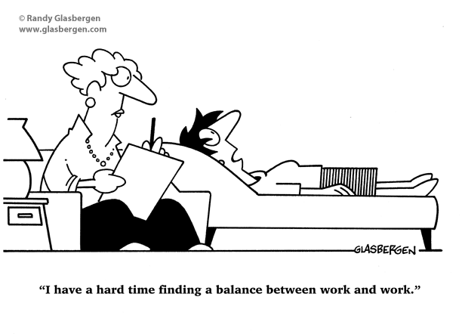

Slide 3
Who here….
...wishes they had more energy to do the things they love to do?
...used to be more efficient at work-life fit?
...struggles to find space in their lives to take proper care of themselves?
...is brave enough to let go of parts of their current life in order to build a better one?

Slide 4
What is your experience with ‘Burnout’?

Slide 5
Is Burnout What You Think It Is?

Slide 6
What I’ve learned from clients struggling with burnout
Burnout started when they were very young – need to track ‘attachment style’
Most people struggling with burnout symptoms have ‘lost their way’
Burnout attacks their body AND mind – recovery requires attention to both
Their body/brain does not differentiate between work stress and ‘life’ stress
There is no quick fix for burnout. BUT, there is a process of recovery that works.
They can usually place themselves along a ‘burnout continuum’

Slide 7
Multiple Stress Events
Stress Build Up
Response Intensity
Stressors
1
2
3
4
5
6
Weeks/Years

Slide 8
Maslach and Jackson (1986)
“Burnout is a psychological syndrome of emotional exhaustion, depersonalization, and reduced personal accomplishment that can occur among individuals (and organizations) that face excessive and prolonged stress.”

Slide 9
Got Burnout?
Burnout is Lost Energy
Burnout is Lost Enthusiasm
Burnout is Lost Confidence

Slide 10
12 stages of
Burnout
Freudenberger and North, 1975

Slide 11
6 workplace Areas that lead to burnout
Working too much - workload
Working with little control
Working for insufficient reward - whether the currency is money, prestige, or positive feedback
Working with little social support community
Working in an unjust environment fairness
Working within a conflict of values workplace values
Taken from “The Truth About Burnout” – Maslach and Leither, 1997

Slide 13
Taken from “Stanford Social Innovation Review” – Maslach and Leither, 2005

Slide 14
What does Burnout Look like?

Slide 15
Unfolding Emotional Sequencing
Fight or Flight
Stress/Anxiety
Indecisive
Inattentive
Angry
Calm
Positive States
Clear Identity
Organized Thinking
Expressive/Creative
Body/Mind
“Survival and Protection”
Body/Mind
“Feeling
Safe – Growth”
B
C
Shut Down
Detachment
Depression
Burnout
Social Isolation
Attuned
Spiritually Connected
Flow
Fearless
Inspired
Body/Mind
“Conserving
Energy”
Body/Mind
“Beyond
Ordinary”
A
D

Slide 16
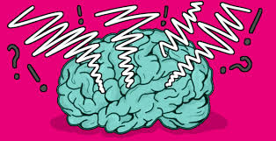
Cognitive Impact of Chronic Stress
Diverted Attention – inability to stay on task until completion (a.k.a. ‘Monkey Mind’)
Foggy Brain – slow thinking, lack of clarity
Increased Anxiety and Rumination (obsession with task completion; waking up at 3:45 thinking about work)
Working Memory Trouble (short term storage; ”Why did I come downstairs again?”)
Difficulty Learning New Concepts – (revert to overuse of ‘What You Know’; new course prep a struggle)

Slide 17
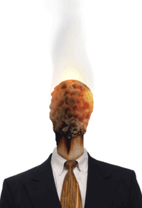
Who is susceptible to Burnout?
Type A Personalities
Perfectionists
Idealistic, rather than realistic people
Single Workers
Women
Workers without kids, hobbies
Helping profess’s (teachers, doctors, nurses, police)
Government employees

Slide 18
Complete the MBI
“Maslach Burnout Inventory”

Slide 20
“I’ve changed careers when my interests changed and passion left. To overcome burnout, I followed my passion to where it went next.”
Taken from “Fried” by Joan Borysenko

Slide 21
What do we do about BURNOUT?
Stop. Listen. Reflect. Ask questions. Find your ‘why’ – your reason for building new habits
Tap into what you are craving, missing, yearning for. Get into nature to go deeper.
Accept the need to change course in your life. Course corrections are healthy, not a sign of failure
Possibly take time off – and follow a wellness plan while away from work
Get sleep/Rest. Nap.
Ensure stress management skills become HABITS: MBSR, daily awareness (charting progress, spotting spiraling, thankfulness, negative perceptions), visualizations, body scanning, mindfulness meditation, nature therapy, yoga, laughter
Exercise/Move regularly and with purpose
Work on your assertiveness/boundaries (permission to say ‘no’)

Slide 22
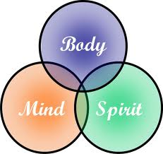
What to do….
Don’t be afraid to ask for help: Medical/Counselling/Coaching/Paramedical
S-L-O-W D-O-W-N on purpose – peel back on commitments and focus on using more ‘automatic’ attention
Allow yourself to grieve the losses – idealism, role at work (“The person who always….”), energy, sometimes friends
Start/finish non-work hobbies or projects – connect to passions/values
Upon return to work, have critical conversations for changes to some of the 6 key areas – workload, control, reward, community feeling, fairness and workplace values

Slide 23
Always come back to your ‘why’
Why would you want to change things?
What is the end game?

Slide 24
Epworth sleepiness Scale
Murray Johns, 1990

Slide 26
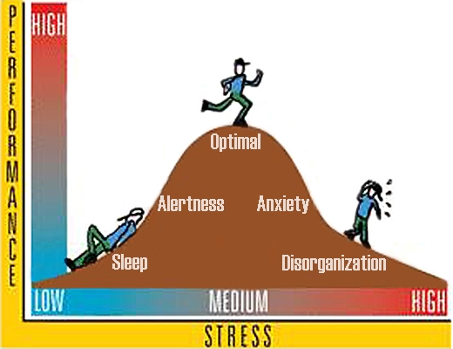
Remember the Yerkes-Dodson Law Stress Performance Connection

Slide 27
Develop Strong Boundaries
Weak/Permeable Strong/Healthy
Boundaries are the invisible barriers that separate you—physically,
emotionally, and spiritually—from the world around you.
Boundaries define who you are and keep you secure.
What “boundary work” might you need to do?
(Boundaries: Where you end and I begin by Anne Katherine, MA, 1991)

Slide 28
Review what you are putting into your body
Food
Supplements
Medication
Alcohol
Other stimulants (coffee, energy drinks)

Slide 29
Always remember….
I am strong.
I am resilient.
I am worth fighting for.
I value my life.
I will adjust to what life throws at me.
I take things one day at a time.
I will never give up.
I am a warrior.
I am ready to change.

Slide 30
Thank you!
MICHAEL LEBLANC
NBTA/EECD TEACHERS’ COUNSELLING SERVICE
michael.leblanc@teacherwellness.ca

