Slide 1
Medical Cannabis Dr. Andrea Burry MSc MD FCFP
NOVEMBER 2017

Slide 2
Presenter Disclosure
Dr. Andrea Burry MSc, MD, CCFP, FCFP
Medical Director of Workplace Cannabis Consulting
Medical Director of Trauma Healing Centers
Medical Advisor WSNB
Occupational Medicine Physician for HorizonNB
Occupational Medicine ExxonMobil (Moncton)

Slide 3
Let’s Talk
Endocannabinoid system; What is it? What does it do?
Current availability of Cannabinoids in Canada (prescription and herbal).
Current Cannabis Regulations; the Access to Cannabis for Medical Purposes Regulations (ACMPR)_August 2016
Therapeutic uses/current evidence for medical cannabis
Notes:
Spelling of Marihuana as opposed to Marijuana; Marihuana with the “h” thought was to have more of a “medical connotation”; we/me/other “cannabis” physicians are further taking that distinction to the term “medical cannabis” to further delineate cannabis for medical purposes as opposed to marijuana for recreational purposes

Slide 4
Why Cannabinoid Medicine ?
Experience with patients having symptoms or conditions for which ”traditional therapies” were either inadequate or causing intolerable side effects
Became aware of the Endocannabinoid System
Real life stories of patients using cannabis who have achieved benefit and improved quality of life
Notes:
It has been here since 2001; although most of us have not had much exposure, I had one patient with approval under the former regulations
With the new regulations, more individuals are looking for legal access

Slide 5
Dr. William O’Shaughnessy
Cannabis used as a medicine for over 5000 years
Introduced therapeutic use of Cannabis to Western Medicine
Used in infantile convulsions and pain of rheumatism
Tetanus victims; case reports of “cure”.

Slide 6
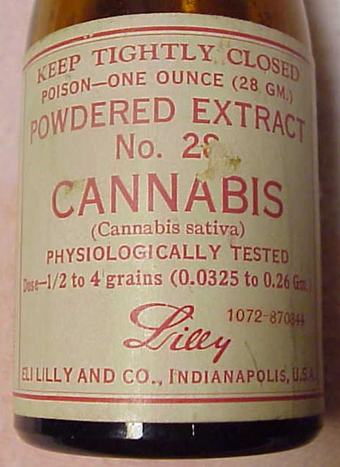
History of Cannabis
Prior to 1910 the word cannabis was used as a as a reference to medicines and household remedies
Pharmaceutical companies such as Bristol-Meyer-Squib and Eli Lilly used cannabis and associated extracts in their medicines
Sir William Osler

Slide 7
MARIJUANA ⌧ CANNABIS
1920s, increased recreational use of cannabis
Started being referred to as Marijuana (Maria-Juana, Mary Jane)
Following Great Depression, white Americans began blaming immigration for recreational use of Cannabis, started to be seen as a “bad thing”

Slide 8
HENRY ANSLINGER; FED. BUR. NARCOTICS
Played pivotal role in prohibition of cannabis
Made public speeches/propaganda films such as “reefer madness”
1937; Marijuana Tax Act; federally criminalized cannabis in every US state
Cannabis no longer available for use as medicine, MDs not involved

Slide 9
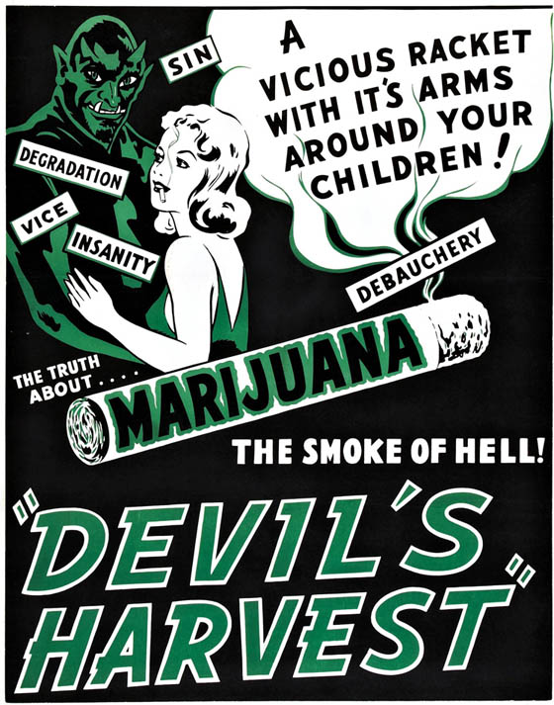
THEN….....

Slide 10
NOW…....
Chemical composition of cannabis is complex
△9-Tetrahydrocannabinol (THC) and cannabidiol (CBD)
THC has many useful effects
30 years of recent research providing some insight into how it works
Discovery of new biological signaling system 1990s, endocannabinoid system, serves crucial functions in maintenance of brain and body function

Slide 11
ENDOCANNABINOID SYSTEM
Receptors; CB1 (Brain and Spinal cord), CB2 (Immune cells)
Endocannabinoids; Anandamide, 2-Acylglycerol (2-AG)
Regulates essential functions such as pain, mood, memory
Deficiency in ECS may play role in development of FM, IBS etc.

Slide 12
THC
THC was isolated from the cannabis plant in 1964 by Dr. Raphael Mechoulam
Anandamide, endogenous cannabinoid, discovered by Dr. Mechoulam in 1992
THC mostly present in cannabis plant as THCA, THCA is non-intoxicating and converted to THC when exposed to heat (decarboxylation)
Act on CB1 and CB2 receptors

Slide 13
CBD
Modulates an enzyme (FAAH) that acts on CB1 receptor and therefore modulates effect of THC (reducing psychoactive effects)
Acts on adenosine receptors; anti-anxiety and anti-inflammatory effects
Not have mind altering/intoxicating
Alleviate psychotic effects in schizophrenia, alleviate anxiety and seizures in some types of epilepsy (*Charlotte’s Web)

Slide 14
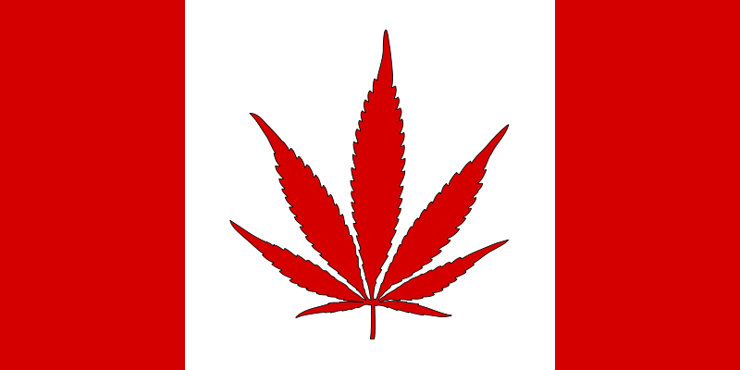
Cannabinoid Availability in Canada

Slide 15
Cannabinoid Availability
Pharmacologic
Nabilone (Cesamet)
Nabiximol (Sativex)
Non-Pharmacologic
Herbal Cannabis (dried flower)
Associated extracts (oils)/capsules

Slide 16
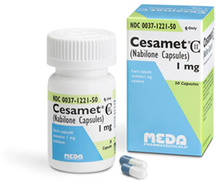
Nabilone
Synthetic Cannabinoid (THC)
Nausea and vomiting associated with chemotherapy and in 1992 treatment of appetite suppression in HIV/AIDS
THC only, CB1/2 receptor agonists
No other cannabinoids, terpenoids/flavonoids that could be potentially therapeutic

Slide 17
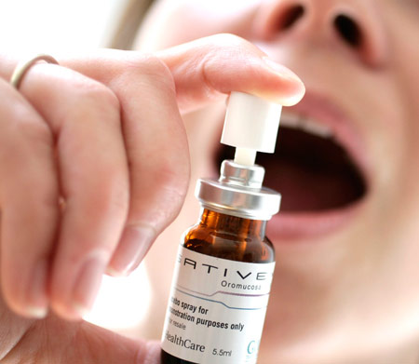
Nabiximols
A “phyto-cannabinoid” even-though it is a pharmaceutical cannabinoid
Herbal Cannabis (whole plant) extract in a oral-mucosal spray
Standardized dose of THC and CBD, 2.7mg THC and 2.5mg CBD per spray
Original use for central pain in MS
Usual dose 1-2 sprays up to 6x/day
$$$$$

Slide 18
Herbal Cannabis/Oils
Used in a variety of clinical scenarios
Often challenging to dose
Variety of strengths of THC/CBD
Different strains, Indica vs Sativa
Inhaled or consumed

Slide 19
Former Regulations-MMAR
2001-2014; Medical Marihuana Access Regulations, Health Canada granted access to medical cannabis through either
Health Canada supply
Home-growing for their own use
A designated grower (through Health Canada)
500 patients in 2001 to over 30 000 in 2013

Slide 20
Former Regulations (MMPR) Marihuana for Medical Purposes Regulations
April 2014; Health Canada no longer issued licenses to patients to grow own
Licensed Producers were initiated
Only legal way to obtain cannabis was through a licensed producer (LP); currently >40 in Canada
Dispensaries are NOT LEGAL!!

Slide 21
Access of Cannabis for Medical Purposes Regulations (ACMPR)
August 24 2016
Replace the MMPR
Medical Cannabis from LP, or apply to Health Canada to produce a limited amount of cannabis for their own medical purposes or designate someone to produce it for them
LPs will be sole legal supply of starting materials
Amount that can be grown will be determined by a formula (maximum daily dose and the average yield per plant)
Individual can possess the lesser of 30 days supply or 150g of dried cannabis or equivalent form
Notes:
Currently 30 LPs in Canada; 1 NB (Organigram), 1 Quebec, 17 in Ontario

Slide 22
Humor Break

Slide 23
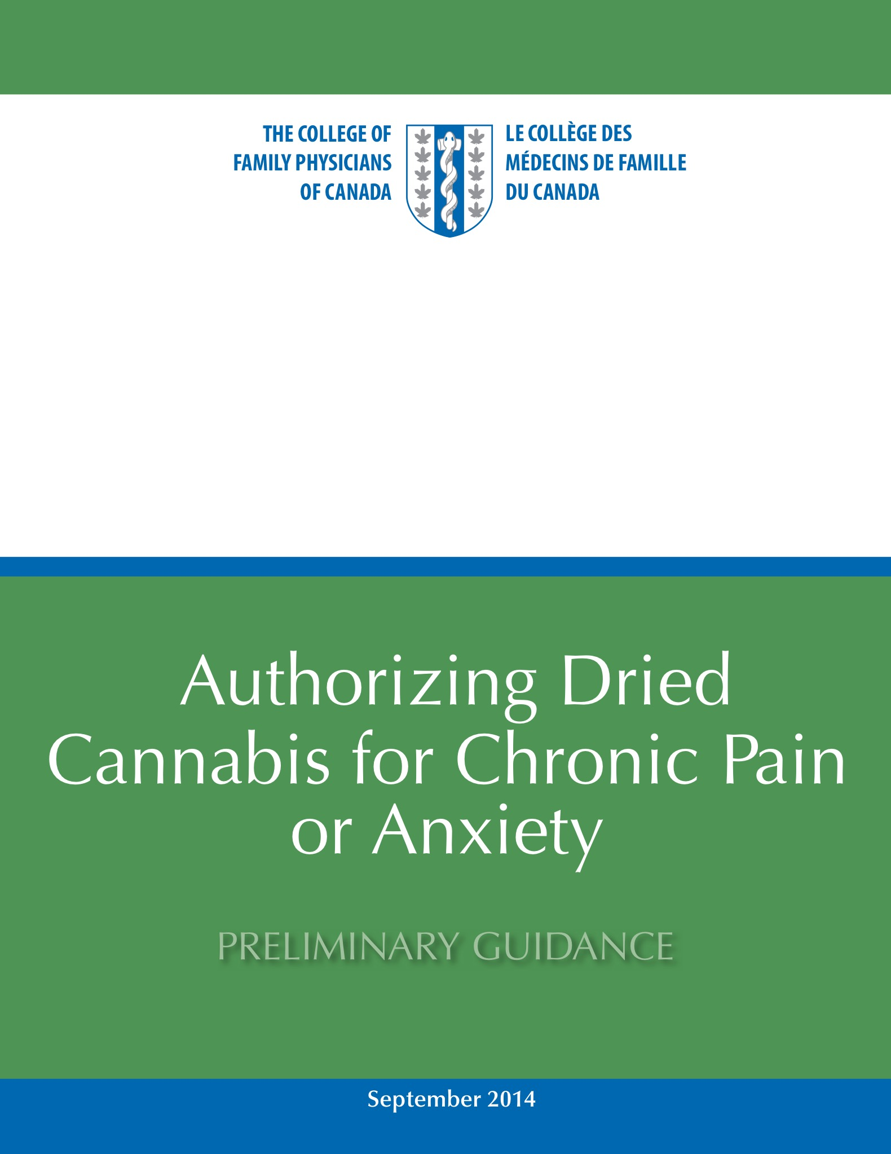
CCFP
Authorizing Dried Cannabis for Chronic Pain or Anxiety; Preliminary Guidance; September 2014
Summary of Recommendations
-only consider for patients with neuropathic pain that have failed standard treatments
-adequate trial of other non-pharmacologic and pharmacologic and pharmaceutical cannabinoids (i.e.Nabilone)
Notes:
Remember that guidance document, NOT guidelines

Slide 24
Canadian Pain Society
Consensus Statement published in Pain Research & Management December 2014
1st line; Gabapentinoids (gabapentin and pregabalin); anti-convulsants; anti-depressants (TCAs, SNRIs)
2nd line; Tramadol/ Opioids
3rd line; Cannabinoids
4th line; SSRIs, Methadone

Slide 25
Benefits: Risks of Medical Cannabis
Management of pain/symptoms (nausea)/PTSD
Reduction of opioids/other medications
Safety profile; impossible to overdose
Cognitive Impairment? Short and Long term
Occupational/Safety Sensitive Job/Driving
Interactions with other medications/substances

Slide 27
RCT smoked cannabis
RCT with 23 pts with NeP assigned MC at 0, 2.5, 6 and 9.4%
25mg; tid, single inhalation with a pipe, tid
Improvement of pain dose dependent with %THC
Significant improvement in sleep quality and anxiety
Notes:
CMAJ 2010

Slide 28
RCT; review of current literature

Slide 29
Lynch and Ware 2015
Systematic review of RCTs on the efficacy of cannabinoids in the treatment of non-cancer pain
RCTs comparing CB to placebo with pain measured as an outcome using any scale, visual or numeric
11 RCTS met criteria, 1185 subjects
Overall CB had analgesic effect superior to control (9 placebo 2 active control (Nabilone or ibuprofen)

Slide 30
CAPRI

Slide 31
CAPRI Trial
Joint Canadian effort; McGill and Dalhousie
Randomized, double blind, placebo controlled, cross over study examining single dose vaporized cannabis with adults with painful knee OA
Goal to understand the analgesic dose response of several varieties of cannabis containing varying concentrations of CBD and THC

Slide 32
Post-Traumatic Stress Disorder

Slide 33
PTSD and CBs

Slide 34
Effects of Nabilone on Treatment Resistant PTSD (Fraser 2009)
Canadian Data; Chart review
Clinical trial using Nabilone, Endocannabinoid receptor agonist on treatment resistant nightmares in patients with PTSD
Charts of patients with treatment resistant nightmares associated with PTSD and poor sleep despite antidepressants and hypnotics were reviewed after Nabilone was initiated
72% receiving Nabilone experienced cessation of nightmares or significant reduction in intensity
Potential benefits of Nabilone and plant derived cannabis in management of symptoms of PTSD
Notes:
Canadian Study. Ottawa

Slide 35
PTSD; RCT_Canadian Study
UBC-Kelowna; Zach Walsh
RCT 40 men and women with PTSD (vets/first responders/sexual assault)
Cannabis (THC)/Placebo
Cannabis (THC) vs (THC/CBD)
2.5g/day; use up to that amount, what is not used is returned and “banked” for future use

Slide 36
Practical Points
No standard “dose”; start low/go slow
Choose functional goals, monitor response
National average use is 1.0 g/day; edibles require more
Vaporize or Oil
ONLY CBD strains while working

Slide 37
Summary
Chronic Pain is a large health burden that affects a great number of people
PTSD has detrimental effects on the individual and their families
Generally challenging to manage
Cannabis may be an option for some
Cannabis may decrease dosing of other medications, i.e. opioids

Slide 38
Summary-2
“Lack of evidence of efficacy is not evidence for lack of efficacy”
Therapeutic potential for medical cannabis cannot be ignored
Need for more research; needs to be done in tandem with patient treatment
Blurring of the lines between medical and recreational use is dangerous (in my opinion); Creating confusion around advocacy for its use as medicine (in my opinion)

Slide 39
Summary-3
CBs synergistic with opioids in relief of pain, therefore requiring less opioids and associated side effects
Side effects tolerable and short lived

Slide 40
Questions??

