Slide 1
Integration of Mind, Body and Spirit through Mindfulness-Based Practices
November 21st, 2017
Jenny Rowett, MEd, CCC-S, LCT
NBCDA – Making Connections: Inspiring Possibilities & Perspectives

Slide 2
Learning Objectives
What is mindfulness?
Life beyond thoughts.
Embodied presence.
Practices and narratives from research.

Slide 3
Mindfulness
A particular way of paying attention in the present moment with your whole being: your mind, body, and spirit.
Mindfulness provides an invitation “to become more familiar with the field of your own body, mind, heart, and life by paying attention in new, more systematic and more loving ways.”
A different “way of being.”
“A radical act of sanity, of self-compassion, and ultimately, of love.” (Kabat-Zinn, 2013)
Notes:
daily sitting meditations during each session, and daily meditation homework such as: mindful walking, mindful eating, mindfulness of thoughts and emotions.

Slide 4
Mindfulness
Mindfulness-Based Stress Reduction (MBSR)
Founder: Jon Kabat-Zinn
Offered at the Stress Reduction Clinic at UMass, created in 1979.
Designed to be offered to patients who were falling through the cracks of the medical system, learning a new relationship with their physical challenges.
Participatory medicine

Slide 5
Mindfulness
“…from our point of view, as long as you are breathing, there is more right with you than wrong with you, no matter what is wrong. Over the next eight weeks, we are going to pour energy in the form of attention into what is right with you – much of which we never notice or take for granted, or don’t fully develop in ourselves – and let the rest of the medical center and your health care team take care of what is “wrong”, and just see what happens.”
(Kabat-Zinn, 2013)

Slide 6
Mindfulness
Full Catastrophe Living (2013)
Title refers to the enormity of our life experiences.
Coming to grips with what is most difficult in life, and to finding room to grow in strength and wisdom.
Finding and coming to terms with what is deepest and best, and most human within ourselves.

Slide 7
Mindfulness
9 core qualities of Mindfulness:
Beginner’s Mind
Acceptance
Non-judgment
Patience
Trust
Non-striving
Letting go
Gratitude
Self-compassion

Slide 8
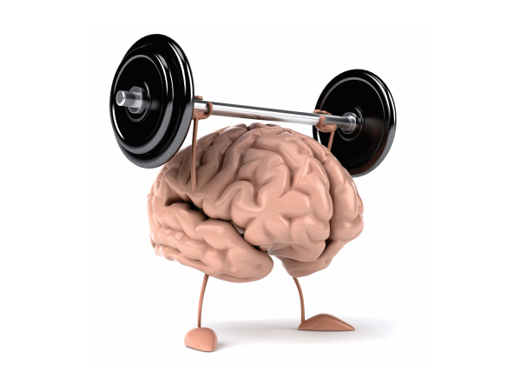
Mindfulness: Grows stronger with use.

Slide 9
Mindfulness
Neuro-plasticity: our brains have an amazing ability to form new connections between neurons, and build new circuitry (neuro-pathways).
“Cells that fire together, wire together.”
This theory was brought forth by Donald Hebb (1949), a Canadian neuropsychologist known for his work in the field of associative learning.
Every experience, thought, feeling, and physical sensation triggers thousands of neurons, which form a neural network.

Slide 10
Mindfulness
Formal practices:
Meditation
Body Scan
Mindful movement such as walking, yoga and tai chi
Informal practices:
Breath awareness
Mindful listening
Mindful eating
All of the rest of your life: are you really where you are, in the present moment?

Slide 11
Mindfulness
Our 1st (formal) practice:
Can be helpful to have a place, an anchor, for your attention to land such as your breath, your feet, and/or your hands.
Usually a distinction is made in meditation practices between ‘concentration’ practices and ‘open awareness’ practices.
When your mind wanders, bring it back to your anchor or point of focus.
Gradually, allow awareness to move away from anchor.
Remember to include the 9 core qualities in your practice.

Slide 12
Mindfulness: Annie Lamott Quote

Slide 13
Mindfulness
Our 2nd (informal) practice:
Bringing joy and gratitude to the every day experience.
Allow different ways of knowing to come alive: taste, touch, sight, smell, and hearing.
Allow yourself to experience through your mind, heart, and body.

Slide 14
Mindfulness: What shall we experience?

Slide 15
Mindfulness
What was your experience of those practices?
Areas of resistance?
Areas of relaxing into?

Slide 16
Life Beyond Thoughts
Our minds are exquisite, however, if not used wisely, they generally want to run the show.
We have 50 000 - 70 000 thoughts/day, or between 35 and 48/minute.
Your thoughts are not You.
What ‘possibilities’ does that open up?

Slide 17
Life Beyond Thoughts
“When I am in extreme moments of stress, that is the reminder that you need to be doing this, and you need to step back and focus...and not get caught in this mist of terrible thoughts…maybe if I focus more on meditating and self-compassion, I might be able to not sacrifice myself so much. I’ve been able to regularly check in and notice when I’m feeling stressed or worried about things, and when I notice that, then I can actually start making some informed actions about how to dissipate that or kind of resolve those feelings of anxiety.”

Slide 18
Life Beyond Thoughts
Proposal: Anchor and Integrate mind, body and spirit.
Versus Scattering
What does scattered feel like?
Integration: A bringing together of mind, body, and spirit
What would that feel like?

Slide 19
Embodied Presence
An opportunity to know and be your wholeness.
Stepping into full ownership of all of your faculties and ways of knowing.
Which gives us unlimited possibilities in the present moment for responding, acting, non-action.

Slide 20
Embodied Presence
Anchor + Integrate = Embodied Presence
Get grounded: bring your mind down into your body. Let your breath anchor you in your body.
Do the work within – building new circuitry within your body as various life experiences unfold.
Utilize a mindfulness-based practice to bring your attention/mind to your body.

Slide 21
Embodied Presence
“Probably a month into meditating regularly I had one particular session where the theme of compassion really came out...all of a sudden, there’s like all this commotion, like really heavy stuff that I had no idea was there...I just started weeping, and there was...shame or disappointment? I just felt like I had really screwed up somehow... And maybe it was just sort of the way I had viewed the world for so long. Out of nowhere, all this emotion came up. And in that moment, it was kind of scary, and I wanted to kind of get away from it but I allowed myself to confront it. I guess I was getting rid of all this baggage or this emotion that I had been carrying around. And I think in that moment...I sort of forgave myself.”

Slide 22
Embodied Presence
Marrying mind and body with breath.
Daily practice of breathwork. Examples:
Central Channel Breath (Dr. Sue Morter)
Sat Kriya (Kundalini Yoga)
Notice emotions or areas of tension/resistance, and integrate them in your body.
Where do you feel it?
Acknowledge it, stay with it, and breathe into it.

Slide 23
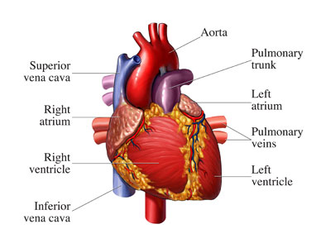
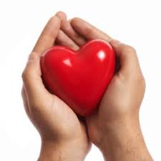
Embodied Presence: Attuning to your heart
Let’s practice: Getting to know your Heart.
Your physical heart
Your emotional or spiritual heart

Slide 24
Embodied Presence
What was your experience?
When we live in embodied presence, we feel more of the heart of life, including the hearts of each other.
“Everything is an opportunity to reveal our magnificence – all the resistance and friction.” (Dr. Sue Morter)

Slide 25
Embodied Presence
“My whole definition of what the self is has been radically changed within the past year. So that has pretty big implications for how I would interpret self-compassion. I really interpret the self as not me as the single unit, but sort of this concept of more of a relationship with everything else that people would perceive as outside of you. And so, if you want to talk about the self, then I’m talking about me, but I’m also talking about you, and I’m talking about all the things that are going on around me, because they’re all related in a way. Those two things have kind of become one and the same, that internal and that external realm. For all intents and purposes, you can remove the self and just say compassion.”

Slide 26
Embodied Presence
Space for new ideas since August☺
Questions/Discussion

Slide 27
Thank You!

