Slide 1


Linking Employment Service Delivery to Labour Market Information Products
Department of Post-Secondary Education, Training and Labour
November 2017
Notes:
*Have Families & Communities as Career Coaches Videos playing as people are coming in.

Slide 2



Session Overview
Objective: to engage in a dialogue about employment service delivery and available labour market information (LMI) products.
Desired Outcomes:
Increased awareness of LMI products
Identified opportunities for improvement of LMI products
Identified of gaps or opportunities in products
Notes:
Total Time: 5 min
Highlighting why we are providing this session and what we hope to get out of the time together; Strategic Services’ role as an enabler branch that develops LMI products and resources to make the role of direct delivery easier.
Mention that an Occupational Video will play at each of the planned breaks. Serves to show a couple of them to people and they last about the length targeted for breaks ☺

Slide 3
Where does the data come from?
Statistics Canada
  Labour Force Survey
  Census
  Other
Occupational Forecasting
  Collaboration with Department of Finance and other key Departments
Ad-Hoc
  Updates from regions, media, analytics of online job ads
Notes:
Total Time: 10 minutes
David
Ensuring that there is a common understanding of where the data behind our LMI products comes from, explaining the impacts of data suppression, the importance of the Labour Force Survey
Explaining the scenarios behind Occupational Forecasting, what triggers PETL to conduct a round of forecasting, the role of other departments
Sharing how someone on the team monitors various media for economic announcements; the availability of analytics for online job postings and importance of hearing from the regions about economic activity.

Slide 4
Identification of Employability Need
Establish a collaborative relationship
Gather information
Verify employability need
Explore challenges
Examine eligibility
Determine next steps
NBjobs.ca Awareness
  Banner Stands
  Handouts
  Swag
NBjobs.ca Job Feed
  Integration of multiple job boards
We’re More than a Jobs Board
Notes:
TOTAL TIME: 25 min
Miriam (5 min)
Discussion around the connection between employment services’ relationship with a client & resources of NBjobs.ca; usage of banner stands/handouts/swag as tools to support this.
David (5 min)
Explaining how NBjobs.ca scrapes the internet for a single job board
Discussing how the site has evolved to be more than a jobs board
Table Activity (15 min)
Ask each table to identify a time keeper and recorder
Have each table discuss the first phase of providing employment services and then brainstorm how NBjobs.ca and/or LMI Products and/or Other Products could support the steps at this point. Remind participants to keep the brainstorming ideas focused on the first 6 steps. Prompt tables to think about the clients that are eligible for services AND those that may not be.
*float around room and collect feedback

Slide 5
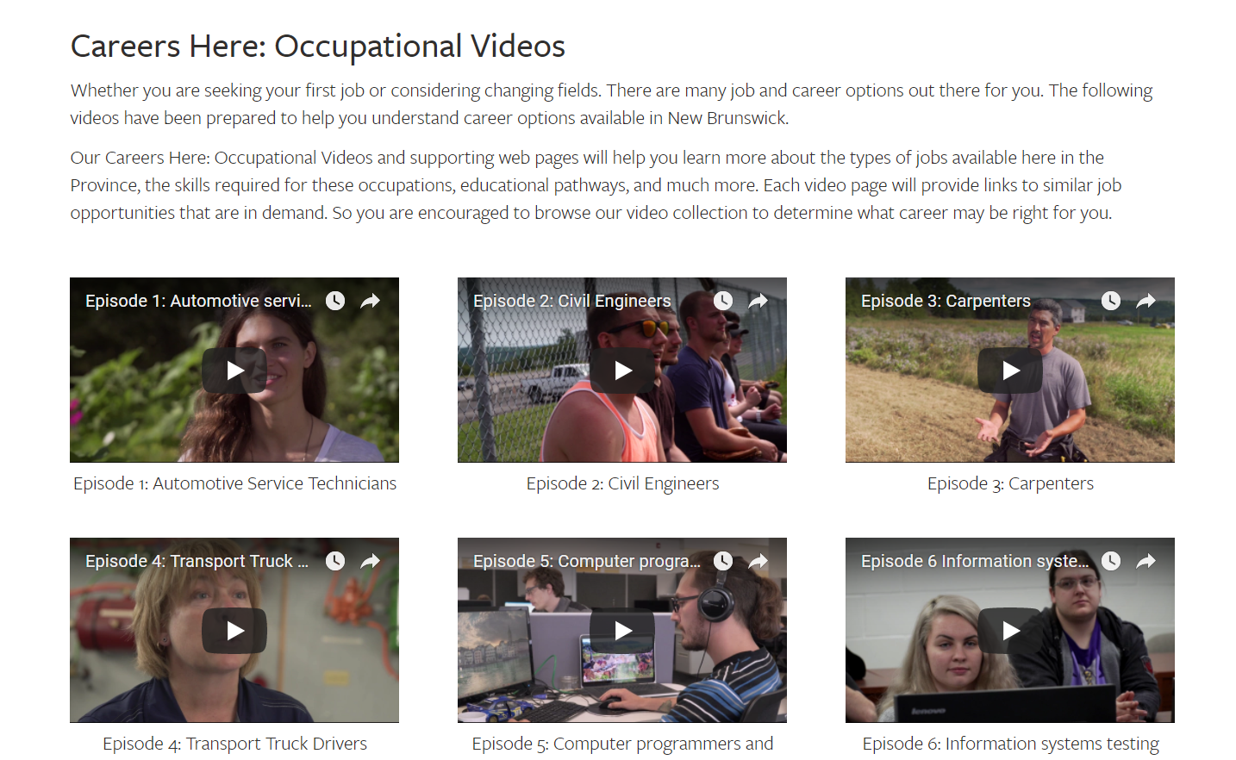
10 MIN BREAK

Slide 6
Clarification of Employment Challenges
Clarify personal and external aspects of the employability challenges
Clarify personal and external resources and limitations in relation to the employability challenges
Clarify client values in relation to the employability challenges
LMI tab
  Hiring Demand Bulletins
  Online Job Posting data
  Labour Force Statistics
  Reports/Surveys
  Infographics/Presentations
  Sector Profiles
Careers & Training Tab
  Educator’s Toolkit
Notes:
TOTAL TIME: 55 minutes
Miriam (5 minutes)
In the second phase of providing employment services, staff are dealing with aspects of employment challenges. Clients are facing a variety of barriers to finding employment and have different values related to those challenges. From an LMI perspective we have products that may be applicable at this phase because they help Employment Counselors understand the environmental conditions for labour in the province &/or economic region.
David (15 minutes)
Hiring Demand Bulletins – where to find on NBjobs.ca, show what it looks like
Online Job Posting data – discuss opportunity to contact central office
Labour Force Statistics – where to find on NBjobs.ca, show what they look like, heads up about the upcoming interactive tool (Miriam)
Miriam (15 minutes)
Walk through the LMI tab’s Reports and Surveys, Infographics/Presentations and Sector Profiles Highlight unique approaches used (Calithumpians, ChatterHigh, Educator’s Toolkit)
Table Activity (20 Minutes)
Have each table identify a time keeper and a notes taker - Ask each table to discuss the second phase of employment service delivery and how NBjobs.ca and/or LMI products support the three steps; THEN record a)positives b)challenges or limitations and c)gaps in tools for this area. Encourage participants to suggest unique ideas.
**We will need to wander around the room and make notes rather than have each table debrief (time saver)

Slide 7
10 MIN BREAK

Slide 8
Development of the Employment Action Plan
Identify goals and generate options
Validate and prioritize options
Develop a mutually agreed-upon Employment Action Plan
Occupational Profiles
Careers Here: Occupational Videos
Occupational Infographics
Skills In Demand
  Public Libraries Portal
Careers by Educational Pathway
Notes:
TOTAL TIME: 55 minutes
Miriam (5 minutes)
In the second phase of providing employment services, staff are dealing with aspects of employment challenges. Clients are facing a variety of barriers to finding employment and have different values related to those challenges. From an LMI perspective we have products that may be applicable at this phase because they help Employment Counselors understand the environmental conditions for labour in the province &/or economic region.
David (15 minutes)
Occupational Profiles, Videos and Infographics– where to find on NBjobs.ca, show what it looks like
Miriam (15 minutes)
Skills in Demand & Careers by Educational Pathway
Open Discussion (20 Minutes)
Ask each table to discuss the phase of employment service delivery and how NBjobs.ca and/or LMI products support the three steps; record a)positives b)challenges or limitations and c)gaps in tools for this area on flip charts in front of the room.

Slide 9

Implementation of the Employment Action Plan
Coordinate intervention activities
Support client progress
Re-assess and/or adjust Employment Action Plan
Finalize Employment Action Plan
Notes:
Total time: 10 minutes
Within the final phase of employment service delivery, clients are engaging in interventions and/or becoming attached to the labour force. Using sticky notes, ask participants to identify two products (if any) that could be made available on NBjobs.ca OR an LMI product that would support their role. Ask participants to provide sufficient detail on the sticky that we will understand what they are looking for. They can post them on a flip chart near the exit on their way out, after any final questions or comments.

Slide 10


Thank you for your time!

